Slide 1
National Hydrology Project
International Seminar
Pune, India
Building knowledge and technology through collaborative water monitoring
Paul Wilson

Slide 2
Agenda
Context and history
Regional Water Monitoring Partnership
Data and technology
Moving from data to information

Slide 3
Victoria, Australia
238,000 km²
(75% size of Maharashtra)
Population 6 million
70% live in Melbourne
25% Australia’s food production ($A15 billion/ annum)

Slide 4
Surface water use
Power generation
2%
Urban and commercial
15%
Domestic and stock
4%
Irrigation
79%

Slide 5
Gauging sites
820 gauges
542 flow
381 water quality
287 telemetered
~2,000 groundwater bores

Slide 6
Why a partnership approach?
1990s sell-off of state hydrographic services
Loss of government knowledge of monitoring and water resource management
Increased costs
Fragmented monitoring, duplication, inconsistent methods
Data analysis disconnected from policy development and decision making

Slide 7
Partnership structure
DELWP
40+ partners, including:
14 water corporations (100%)
10 CMAs (100%)
40+ partners, including:
12 local councils (45%)
State and Commonwealth
40+ partners, including:
Northern Co-ordinator
Outsourced service providers
Southern Co-ordinator
Advisory Committee
Chairs Committee
Technical Reference Committee

Slide 8
Partnership structure
The Partnership has simplified the procurement process:
CMAs
SRW
GMW
DELWP
MW
BoM
Local
Councils
Transparent Cost Sharing - Partnership Arrangement
Single well-specified contract
Service providers
Co-ordinated Network

Slide 9
Partnership approach
Co-ordinated and consistent state-wide approach
State owns the data
Uniform standards which are fit for purpose
Cost is shared between partners
Engaged partners
Extremely flexible approach
Advances in technology and increased accuracy in data collection

Slide 10
Contracts
Outsourced data model
2 major contracts
Field services
Lab services
Contract is between DELWP and the service providers
Formal Agreement between DELWP and all partners
$A10 million/ year (515 million INR)
Total contract value $A80 million (4100 million INR)

Slide 11
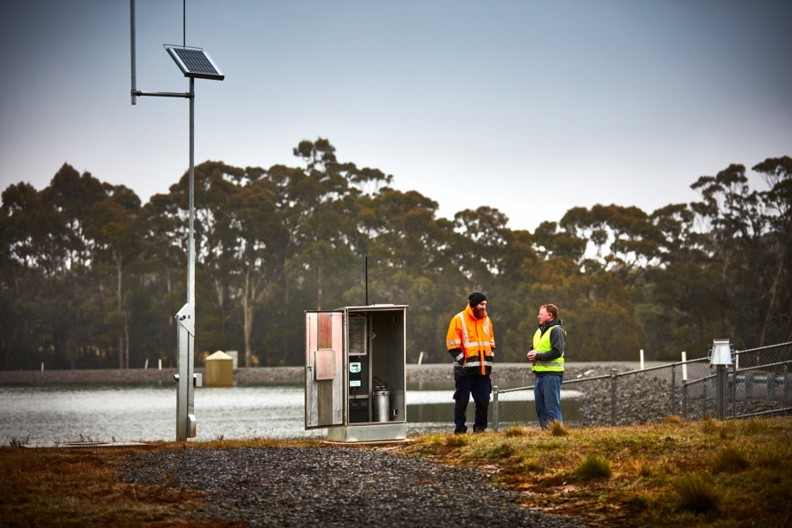
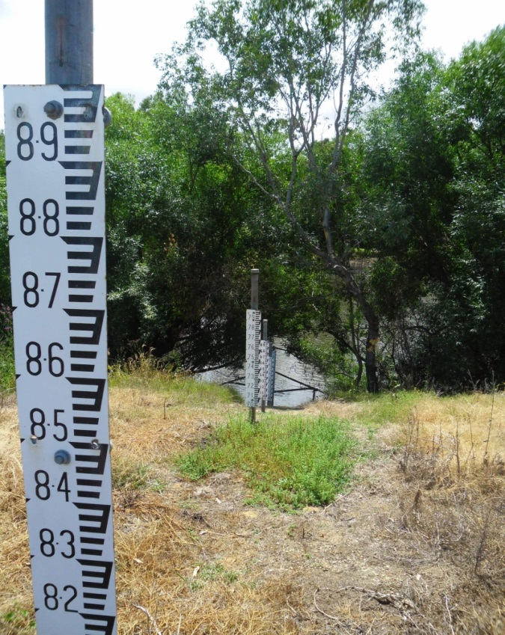
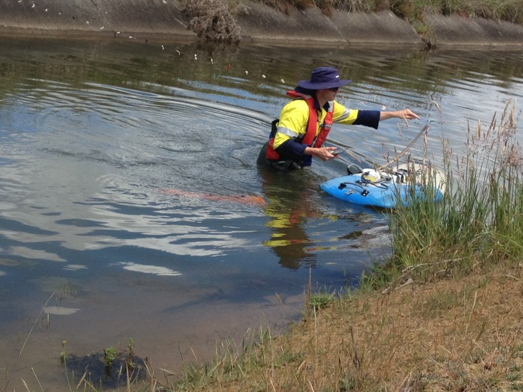
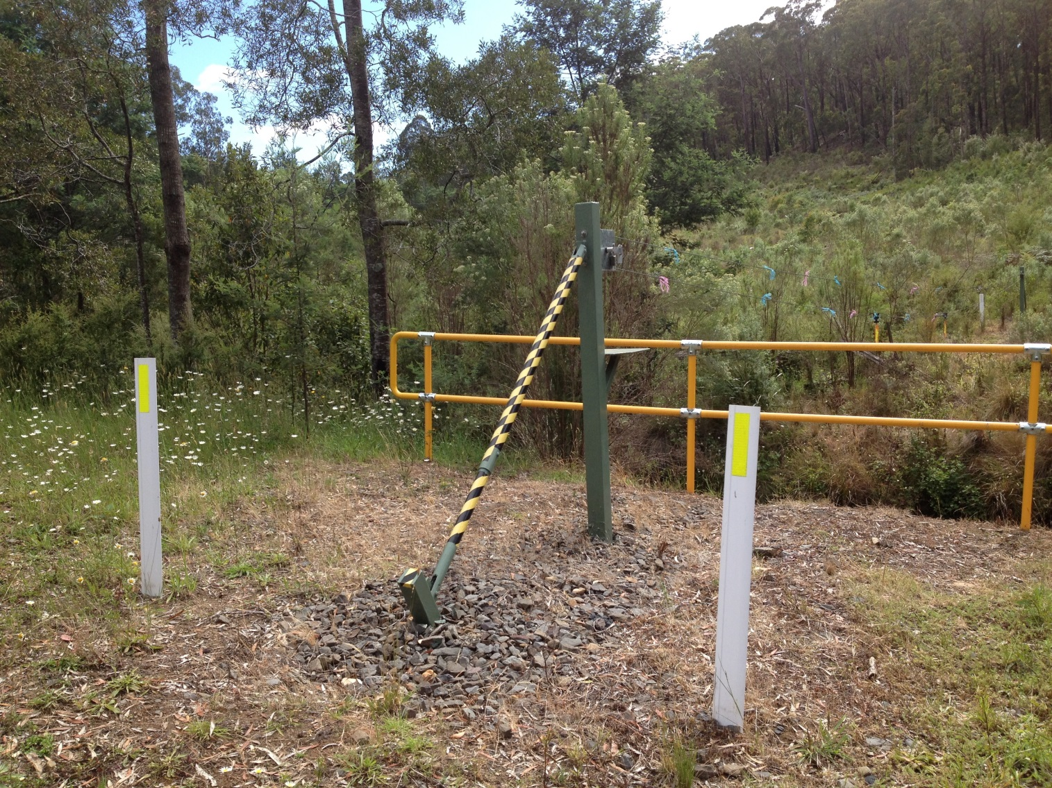
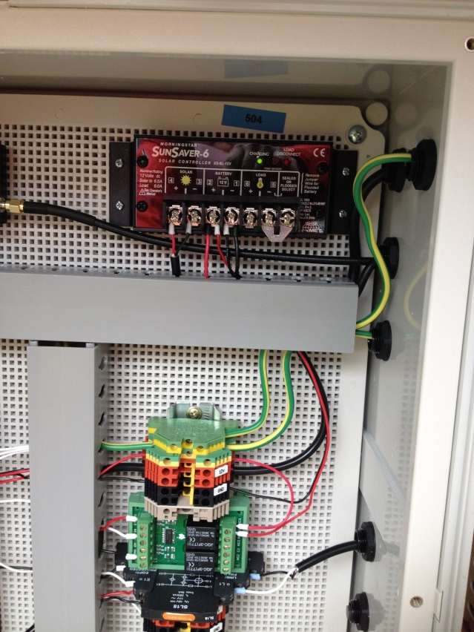
Data collection

Slide 12
Data transfer
Service providers
Real-time data
DELWP
BoM
Partners
Web- and app-based, publically available
Web-based, publically available
Floodzoom
QA/QC
Not publically available
Verified data — monthly
DELWP
BoM
Water register
Web-based, publically available

Slide 13
Maintenance and other services
Monitoring and maintenance
Extra Works (25% of total budget)
Equipment Maintenance Fund (<10% of total budget)
Flood damage – separate budget
Equipment trials (in partnership with service provider)
Regional co-ordinators
Management, billing, databases and publication of data – paid for DELWP

Slide 14
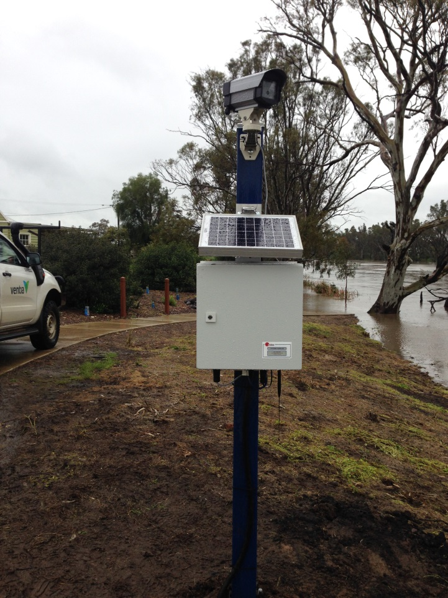
Technology
Technical Reference Group
Real time data
Portable Automated Loggers (PALs)
Flood intelligence platform
Modums vs radio transfer
M2M communication
Drones
Endless wires and OH+S
Site runner

Slide 15
Technology
Subscription Notification Service
Digital Transformation Development underway
Mobile apps to show daily storage levels
working to provide more than just figures

Slide 16
Moving from data to information
New emphasis
Wider scope – rock fish ramps
Change in messaging
Can not under take: compliance, water allocation, measure water use, modelling and reporting (daily/ weekly/ monthly/ annual), without monitoring data.
Evidence-based decision making
Decisions made based upon the most up-to-date data and information

Slide 17
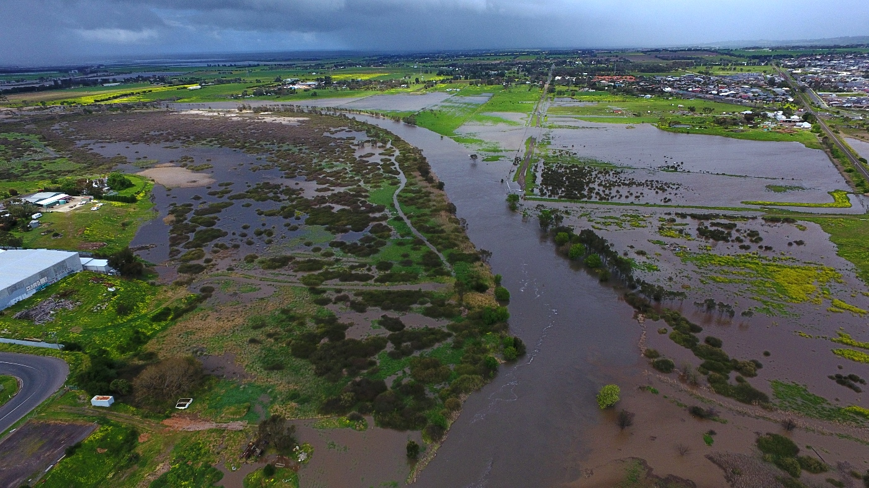
Benefits
Consistency and state-wide coverage
Cost sharing
Central tendering and contracting
Market power to reduce costs
Engaged partners
Evidence based decision making

Slide 18
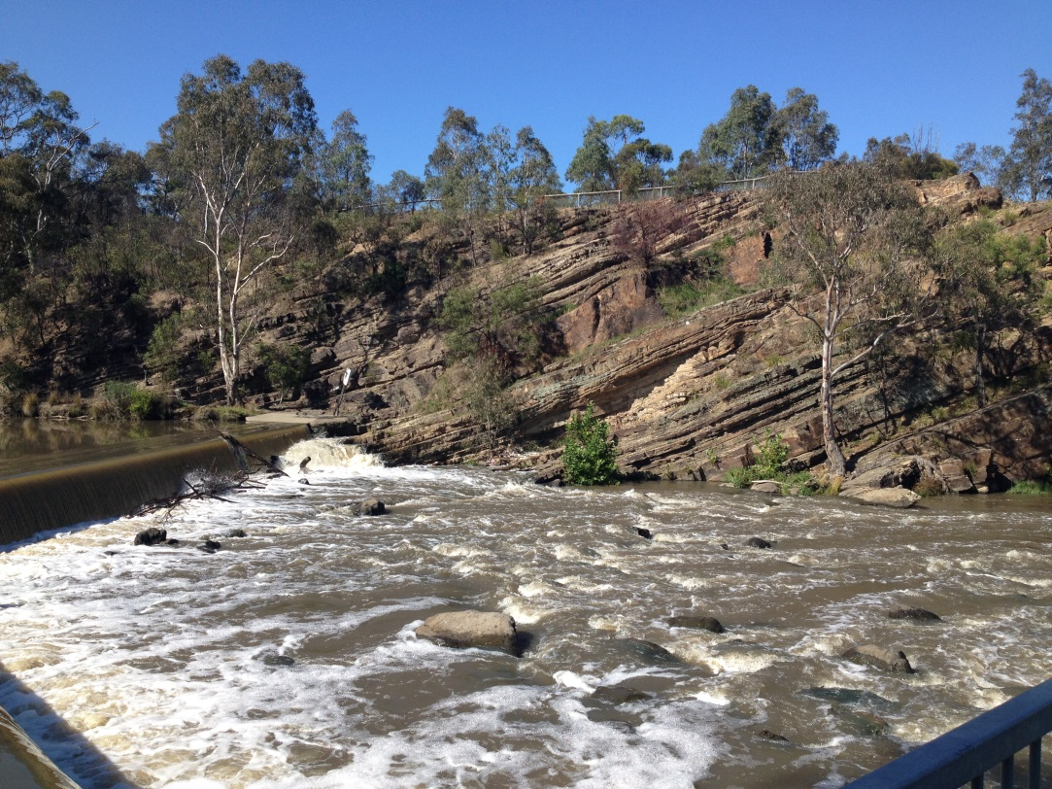
Thank you
Australian Water Partnership
Austrade
Liveability Victoria International

